Slide 1
Incident Response Documentation: Identification of Affected System via Malicious HTTP using wireshark (Packet Analysis)
BY: AKINKOYE OLUWAFEMI

Slide 2
Objective: The purpose of this step is to determine which system on the network accessed the potentially malicious / fake URL.
Tool Used: Wireshark

Slide 3
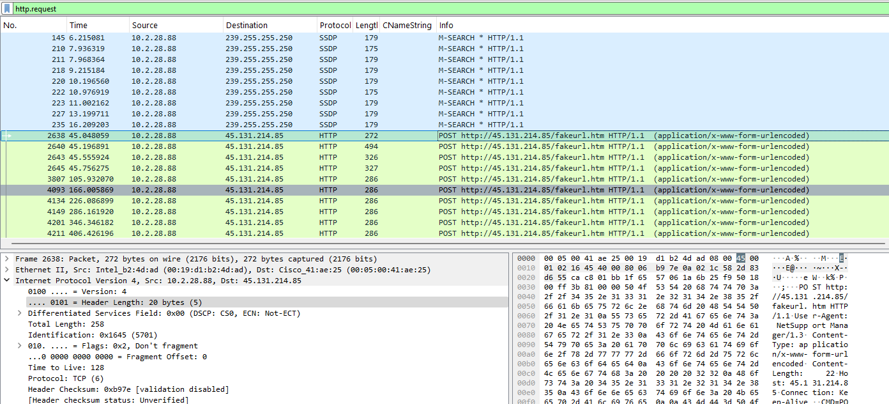
FILTER APPLIED: http.request
The system that accessed the malicious URL is identified by the source IP address (10.2.28.88). This device sent multiple HTTP POST requests to the external server at destination IP (45.131.214.85), specifically to the URL http://45.131.214.85/fakeurl.htm. Since the source IP initiated contact with the malicious server, 10.2.28.88 is considered the victim system. The repeated POST requests indicate ongoing communication. Port: 443 (HTTP)
MAC ADDRESS OF THE VICTIM:
00:19:d1:b2:4d:ad

Slide 4
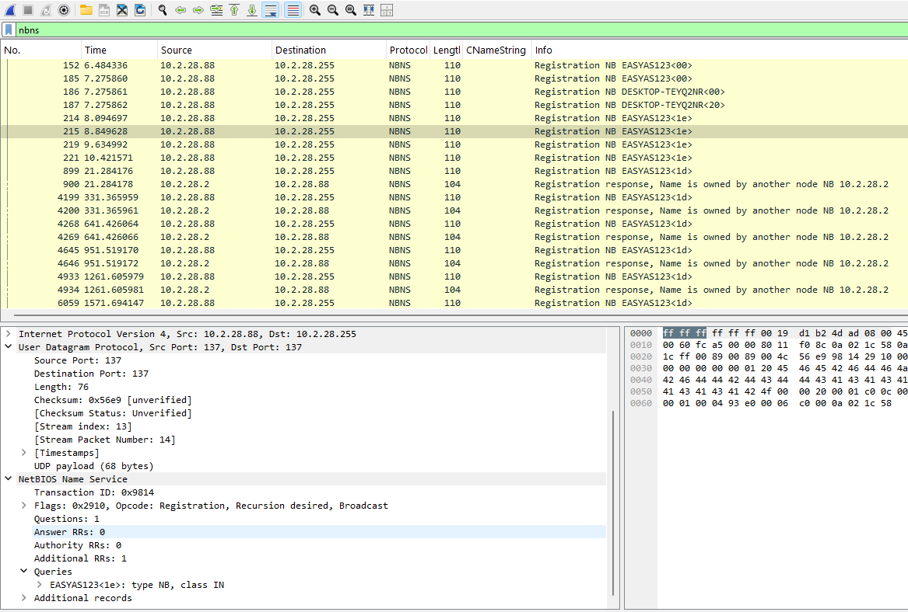
FILTER APPLIED: nbns The device with IP address (10.2.28.88) was queried using the NetBIOS Name Service (NBNS) on UDP port 137 to identify its network name. The system responded with the registered NetBIOS name “EASYAS123” linked with the infected IP address (10.2.28.88), confirming the identity of the device that accessed the malicious URL.
PORT: 137
DEVICE NAME: EASYAS123
PORT: 137

Slide 5
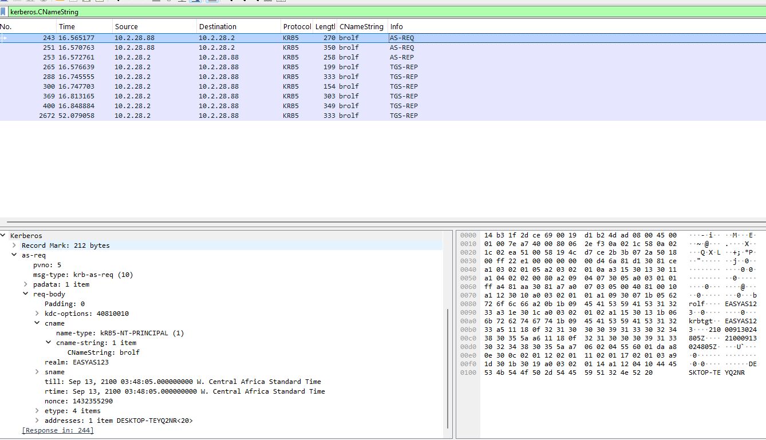
FILTER APPLIED: kerberos.CNameString The system with IP address (10.2.28.88) was analyzed using Kerberos authentication packets, specifically the CNameString field, to identify the user account associated with the device. The captured packets revealed that the username “Easyas123” is linked to the victim system. Port: 88 (Kerberos)
USERNAME: brolf
DEVICE NAME: EASYAS123
PORT: 137

Slide 6
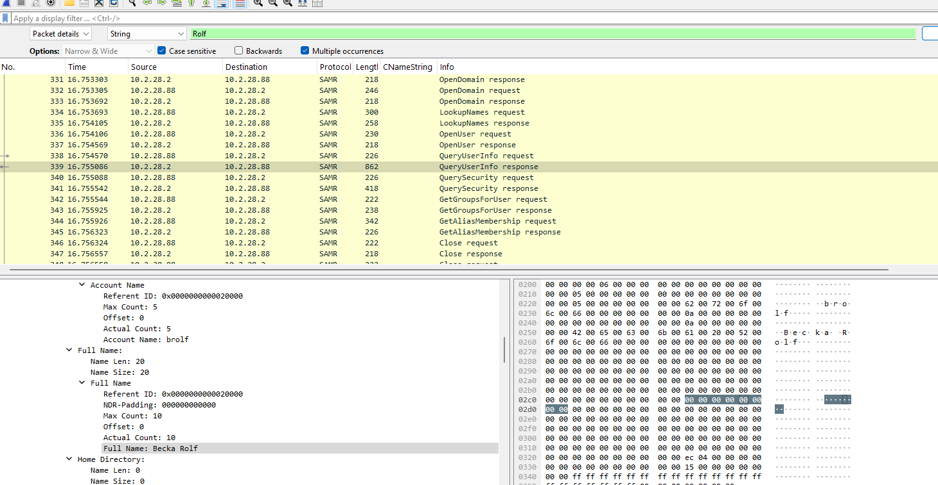
Edit → Find Packet (“brolf”, “rolf”, “Rolf”) After identifying the username linked to the device (10.2.28.88) using Kerberos CNameString, the Find Packet feature in Wireshark was used to filter all packets associated with this username. Analysis revealed that the activity originated from the user Becka Rolf, confirming the individual associated with the victim system.
FULL NAME: BECKA ROLF

Slide 7
CONCLUSION
The investigation successfully traced the malicious HTTP activity originating from the source IP address 10.2.28.88. Through a series of analyses, starting with HTTP POST request filtering which detected the Internal IP(10.2.28.88 ) that connected to a malicious site (45.131.214.85), device identification via NBNS (UDP 137) reveales the device name as “EASYAS123” , user association via Kerberos CNameString which revealed the Username as (brolf), and packet filtering, the victim system and the responsible user, Becka Rolf, were clearly identified. This stepwise approach demonstrates the importance of correlating network traffic, device information, and user credentials in incident response.

